Slide 1

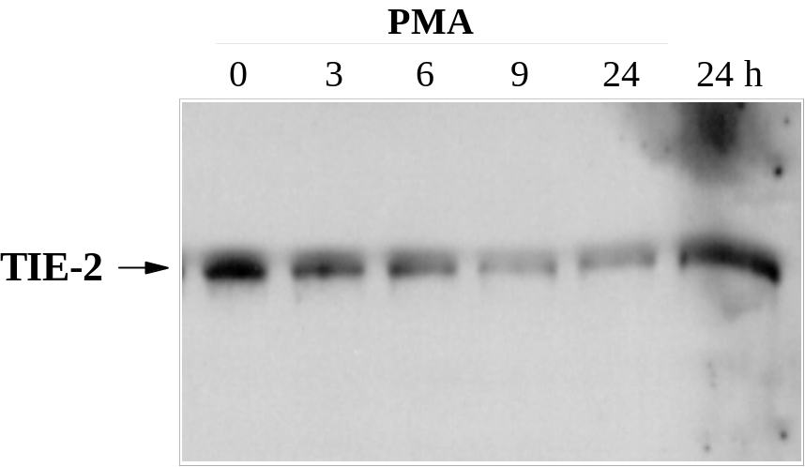
ReliaTech GmbH
Mouse anti-human TIE-2 #tek16
(Cat #101-M54 / #101-M50)
Figure 1: Effects of PMA treatment on TIE-2 . HUVECs (passage 1) were stimulated for the indicated periods of time with PMA at 25 ng/ml or left untreated. Western blot analysis for the presence of TIE-2 protein by immunoprecipitation using antibodies directed against the extracellular domain of human TIE-2 (IP: tek16 [#101-M54]; WB: tek2 [#101-M50]).
http://www.reliatech.de / orders@reliatech.de

